Slide 1
Abaqus Python
Abaqus Python Scripting
Learn with the concepts
Lec 9 – Write Field Data

Slide 2





Share
Share
Subscribe
Like
Subscribe
Like
Comment
Comment
Download files used in this lecture:
Python Script
Data file
ODB file
Explanation ppt
https://github.com/Abaqus-Python/Lec9_Write-Field-Data

Slide 3
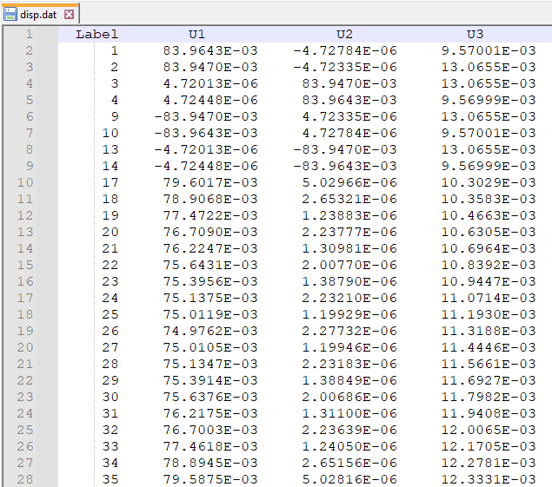
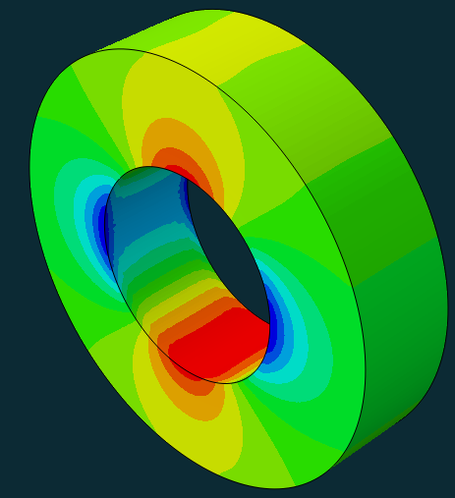



Visualize data as a contour:

Slide 4

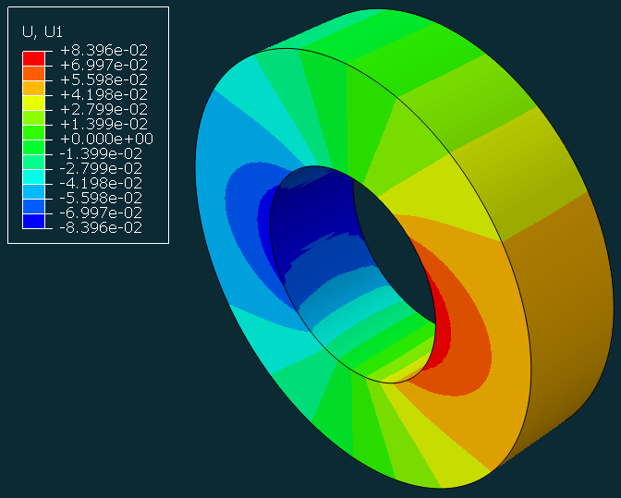
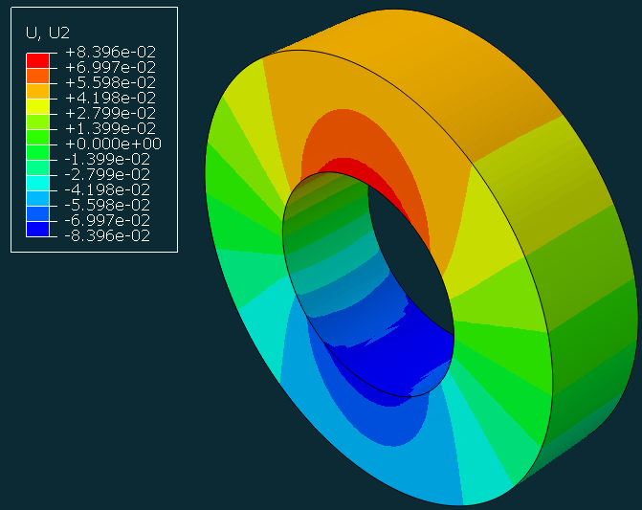
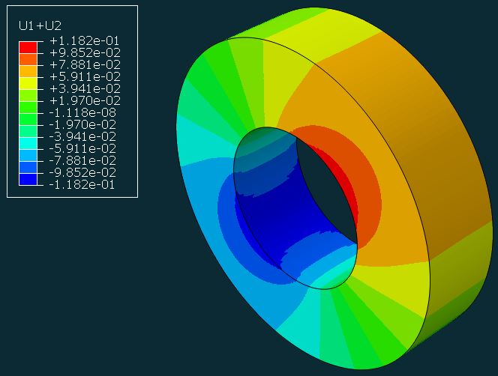
Create New contours:
U1
U2
U1+U2

